Slide 1


Power BI - Project

Slide 2

Home Page
Notes:
image
No alt text provided
textbox
No alt text provided
image
No alt text provided
actionButton
No alt text provided
actionButton
No alt text provided
actionButton
No alt text provided
actionButton
No alt text provided
actionButton
No alt text provided

Slide 3
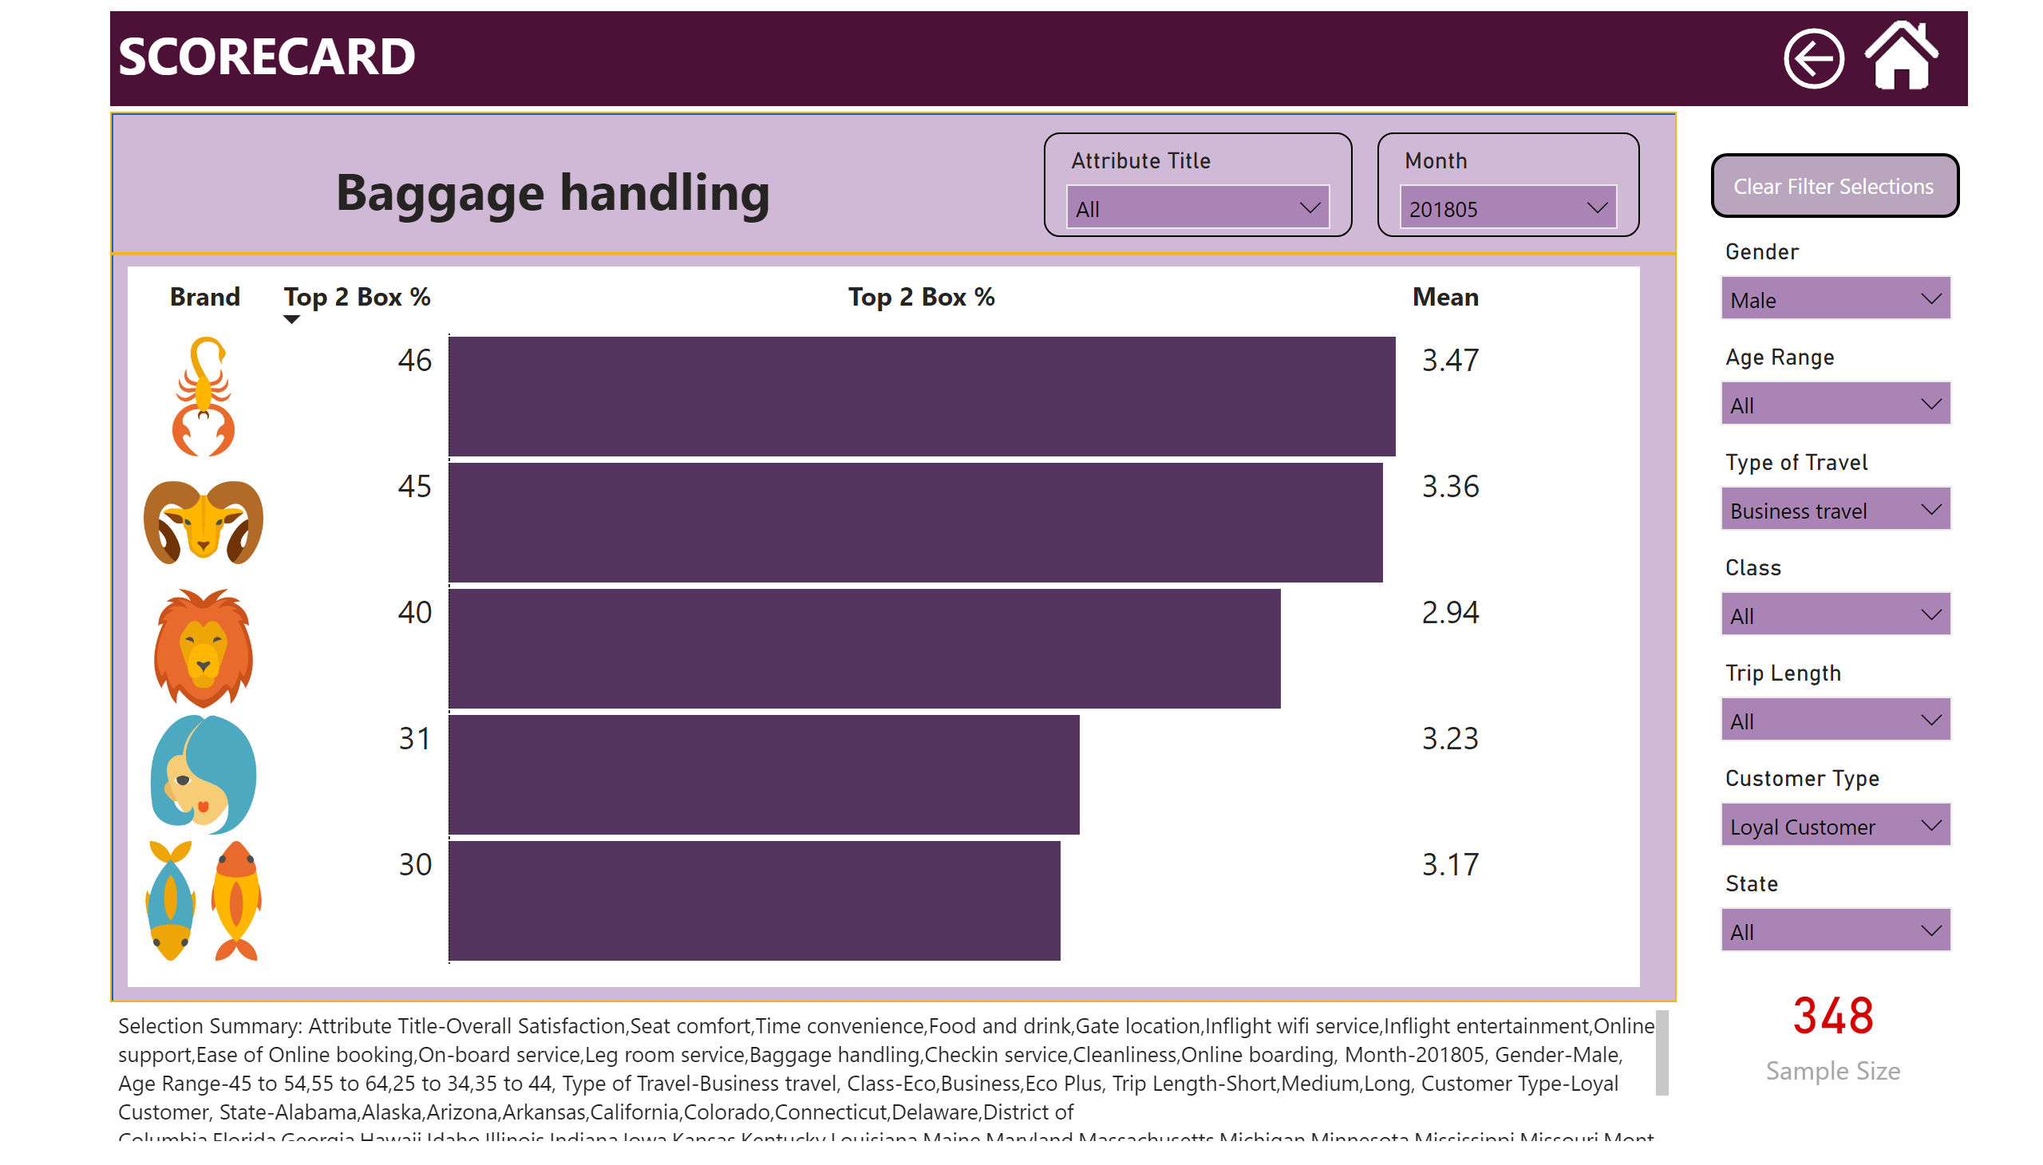
Scorecard
Notes:
pivotTable
No alt text provided
slicer
No alt text provided
slicer
No alt text provided
slicer
No alt text provided
slicer
No alt text provided
slicer
No alt text provided
slicer
No alt text provided
slicer
No alt text provided
slicer
No alt text provided
slicer
No alt text provided
shape
No alt text provided
shape
No alt text provided
textbox
No alt text provided
image
No alt text provided
textbox
No alt text provided
advanceCardE03760C5AB684758B56AA29F9E6C257B
No alt text provided
textbox
No alt text provided
actionButton
No alt text provided
actionButton
No alt text provided

Slide 4
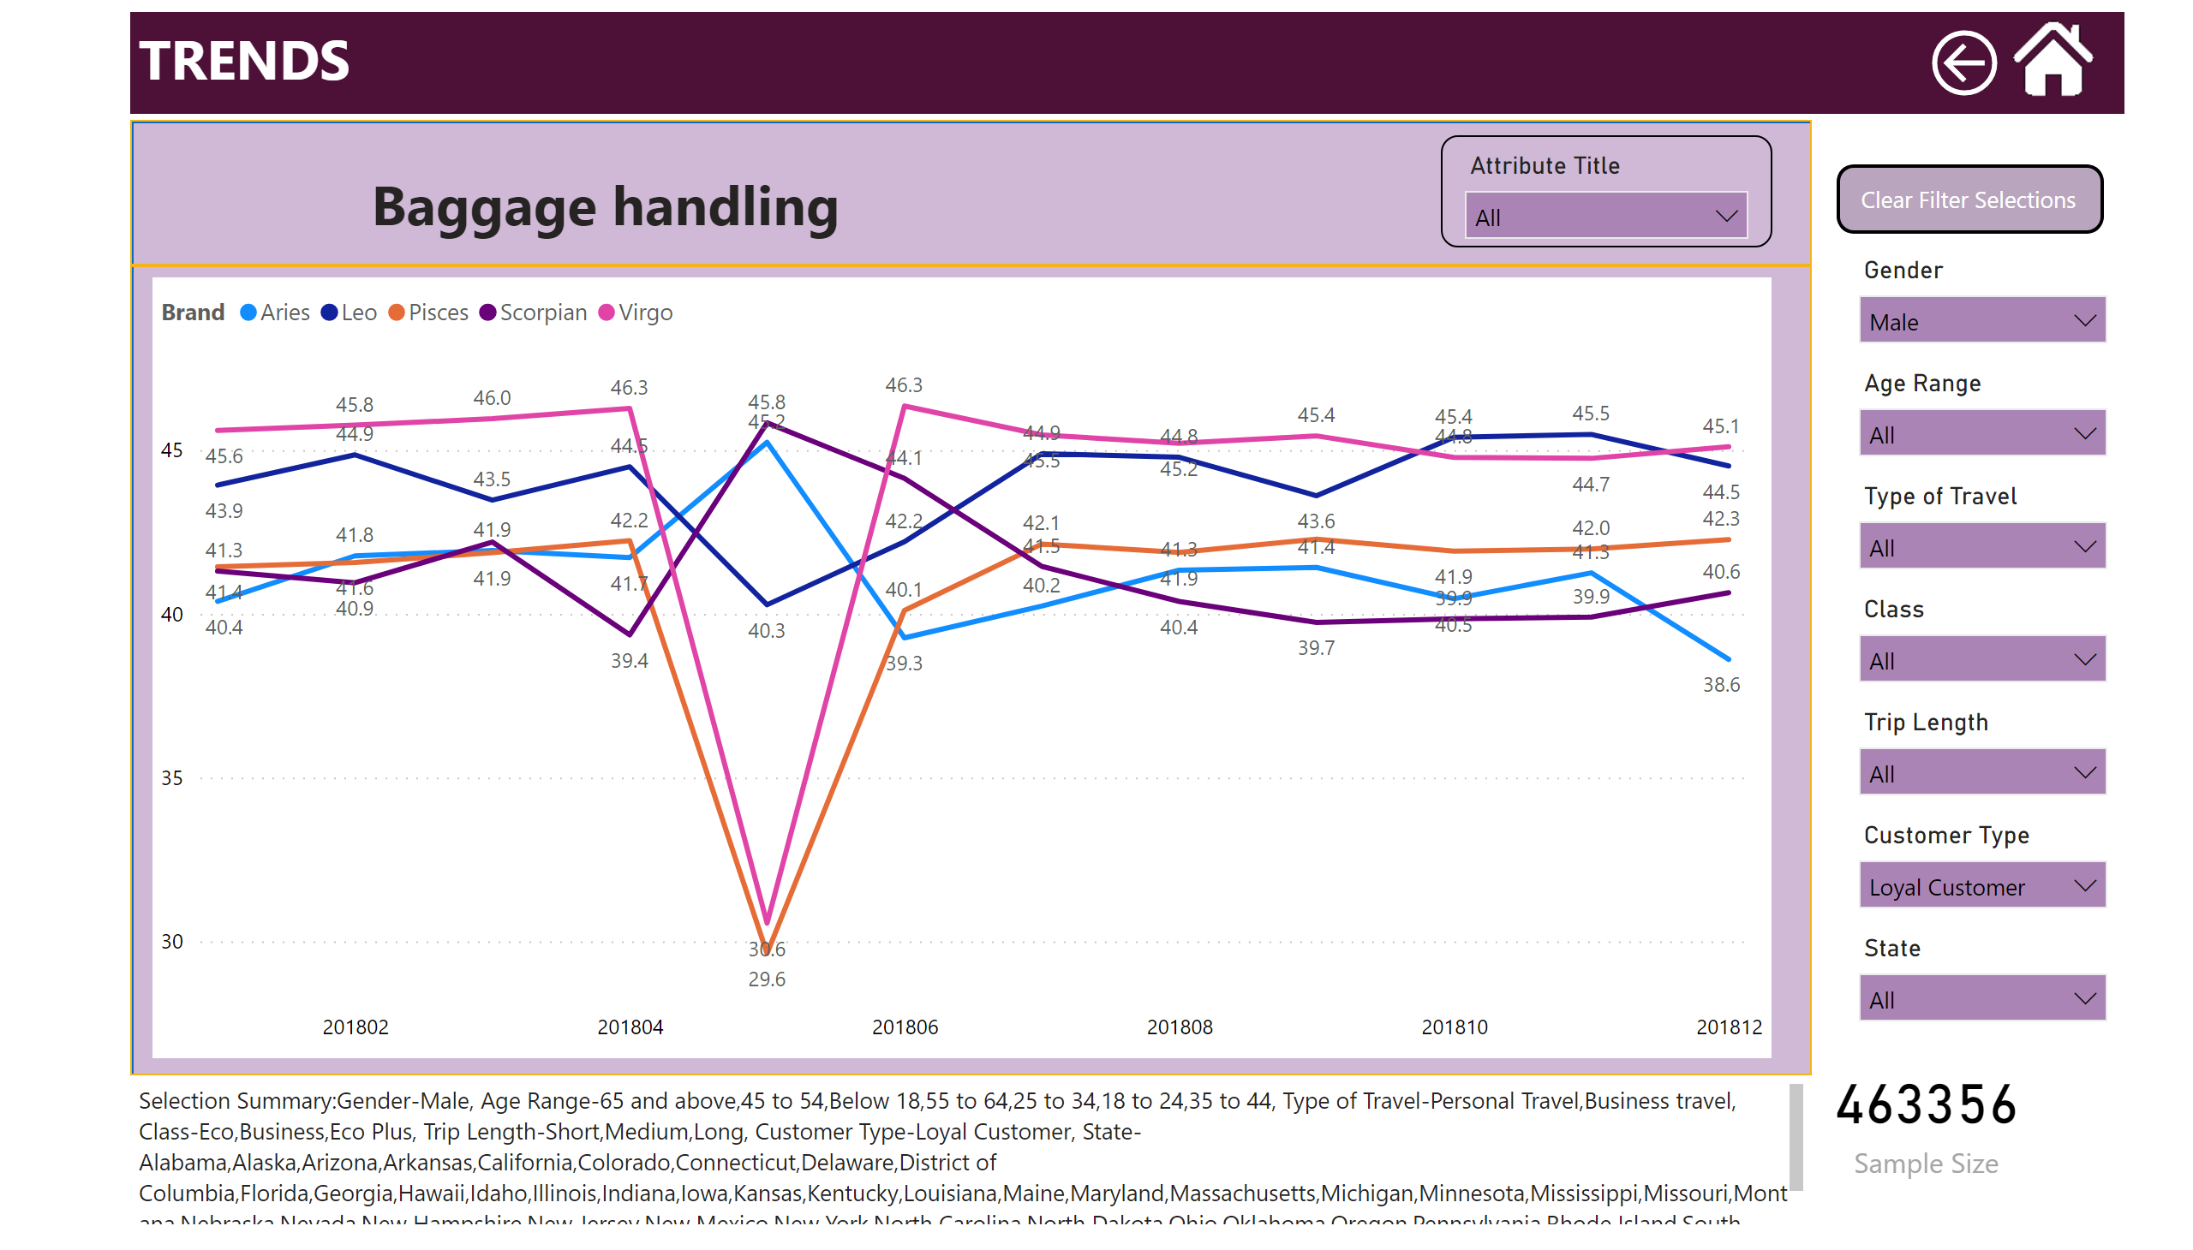
Trends
Notes:
slicer
No alt text provided
slicer
No alt text provided
slicer
No alt text provided
slicer
No alt text provided
slicer
No alt text provided
slicer
No alt text provided
slicer
No alt text provided
slicer
No alt text provided
shape
No alt text provided
shape
No alt text provided
textbox
No alt text provided
image
No alt text provided
lineChart
No alt text provided
textbox
No alt text provided
advanceCardE03760C5AB684758B56AA29F9E6C257B
No alt text provided
textbox
No alt text provided
actionButton
No alt text provided
actionButton
No alt text provided

Slide 5
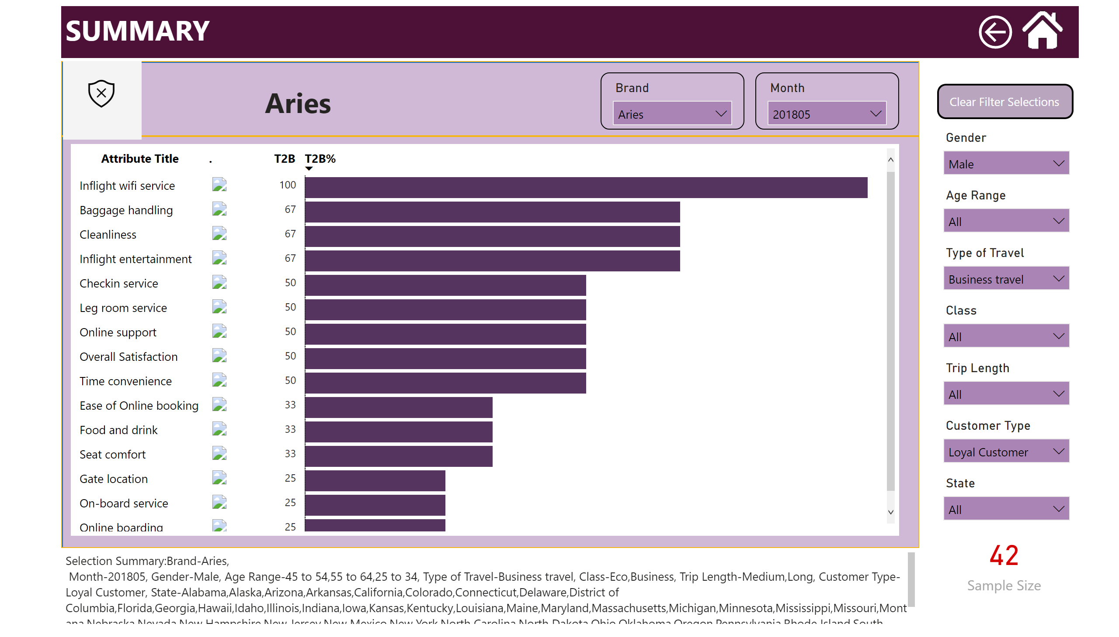
Summary
Notes:
slicer
No alt text provided
slicer
No alt text provided
slicer
No alt text provided
slicer
No alt text provided
slicer
No alt text provided
slicer
No alt text provided
slicer
No alt text provided
slicer
No alt text provided
shape
No alt text provided
shape
No alt text provided
textbox
No alt text provided
image
No alt text provided
slicer
No alt text provided
slicer
No alt text provided
pivotTable
No alt text provided
textbox
No alt text provided
textbox
No alt text provided
PBI_CV_81BBAD08_3ADD_466C_8819_9FACA21A6B8F
No alt text provided
advanceCardE03760C5AB684758B56AA29F9E6C257B
No alt text provided
textbox
No alt text provided
actionButton
No alt text provided
actionButton
No alt text provided

Slide 6
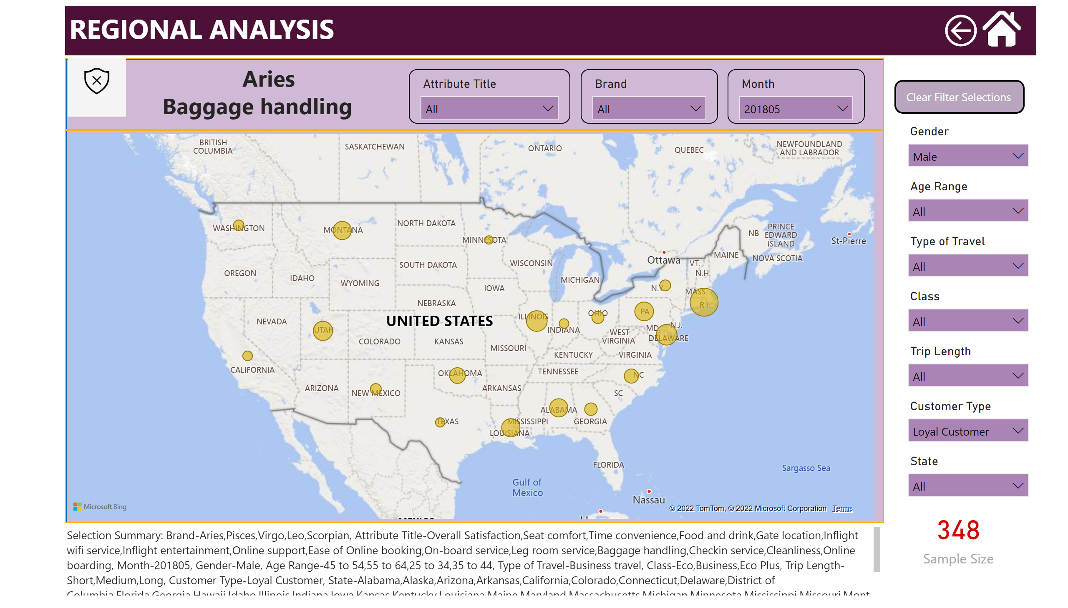
Regional analysis
Notes:
slicer
No alt text provided
slicer
No alt text provided
slicer
No alt text provided
slicer
No alt text provided
slicer
No alt text provided
slicer
No alt text provided
slicer
No alt text provided
slicer
No alt text provided
shape
No alt text provided
shape
No alt text provided
textbox
No alt text provided
image
No alt text provided
slicer
No alt text provided
slicer
No alt text provided
slicer
No alt text provided
map
No alt text provided
textbox
No alt text provided
textbox
No alt text provided
PBI_CV_81BBAD08_3ADD_466C_8819_9FACA21A6B8F
No alt text provided
advanceCardE03760C5AB684758B56AA29F9E6C257B
No alt text provided
textbox
No alt text provided
actionButton
No alt text provided
actionButton
No alt text provided

Slide 7
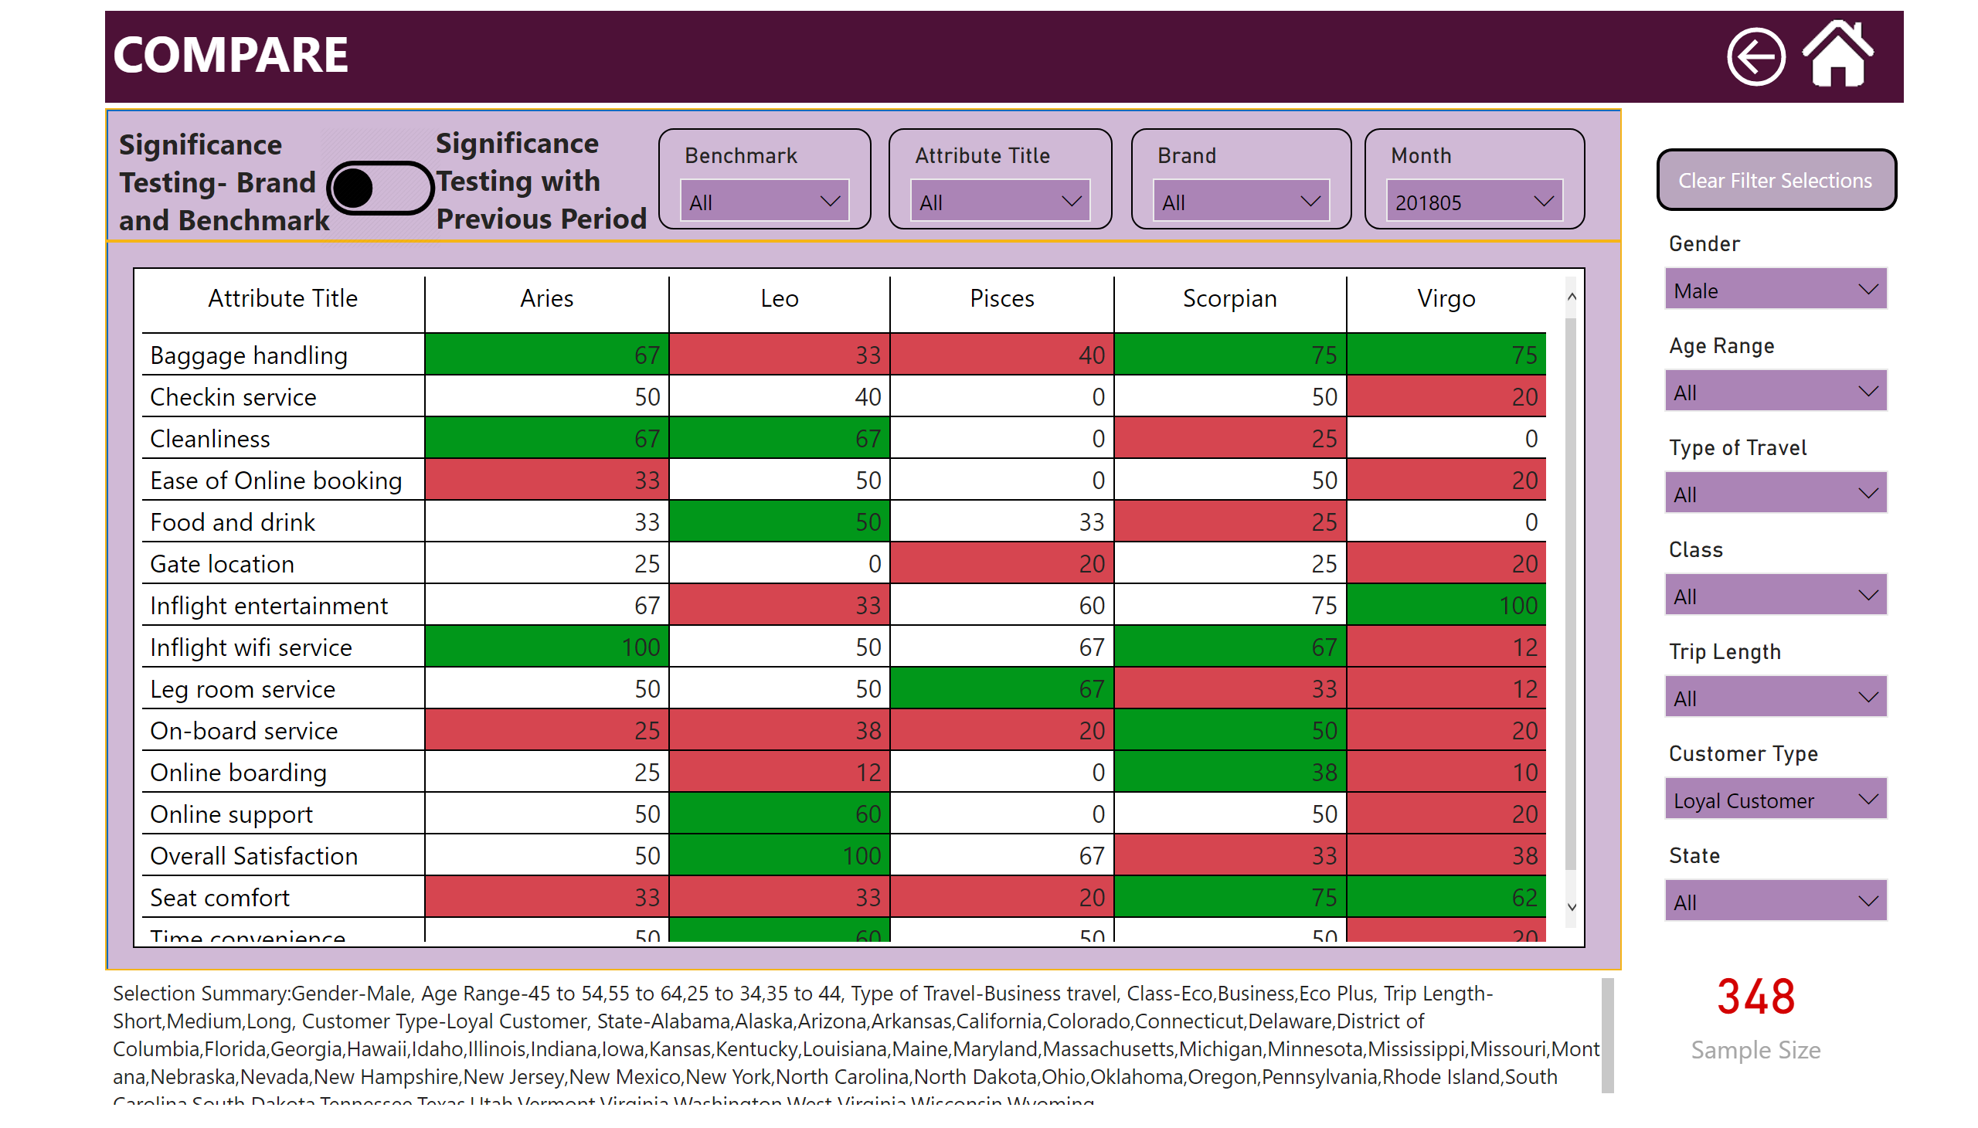
Compare
Notes:
slicer
No alt text provided
slicer
No alt text provided
slicer
No alt text provided
slicer
No alt text provided
slicer
No alt text provided
slicer
No alt text provided
slicer
No alt text provided
slicer
No alt text provided
shape
No alt text provided
shape
No alt text provided
textbox
No alt text provided
slicer
No alt text provided
slicer
No alt text provided
slicer
No alt text provided
pivotTable
No alt text provided
pivotTable
No alt text provided
slicer
No alt text provided
image
No alt text provided
image
No alt text provided
textbox
No alt text provided
textbox
No alt text provided
image
No alt text provided
advanceCardE03760C5AB684758B56AA29F9E6C257B
No alt text provided
textbox
No alt text provided
actionButton
No alt text provided
actionButton
No alt text provided

Slide 8
